Slide 1
Aid Escalating Internet Coverage
Team Name: Zero Accuracy
MT2022080 Prateek Chhimwal
MT2022078 Prasad Magdum

Slide 2
COVERED SO FAR
Evaluation 1
Data pre-processing
Exploratory Data Analysis
Text Preprocessing (nltk-Library)
TF-IDF (Word Embedding Technique)
Logistic Regression Classifier
Evaluation-2
Prediction of column “alchemy_category”
Prediction of column “alchemy_category_score”
Word2Vec
XGBoost
Stacking ensemble (KNNC,SVC,RF,GNB, meta model Logistic Regression)

Slide 3
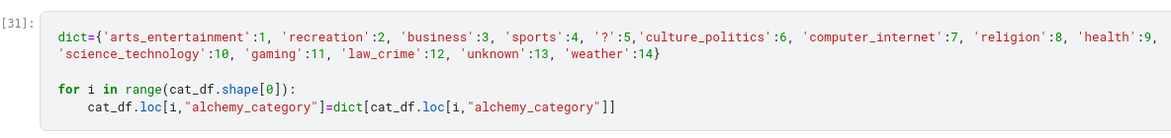
PREDICTION OF “alchemy_category”
Prediction of column alchemy_category
Data corresponding to “?” put into testing dataset.
Rest of the data taken as training dataset.
It becomes multiclass classification task.
Applied Decision Tree Algorithm to achieve this task.

Slide 4
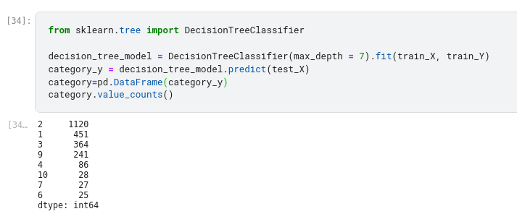
MULTICLASS CLASSIFICATION USING DECISION TREES
Replaced “?” with the corressponding predicted values.

Slide 5
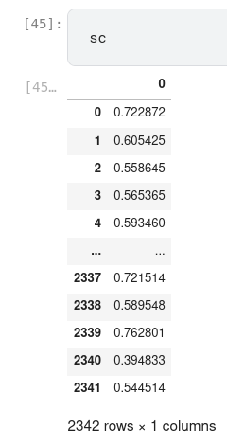
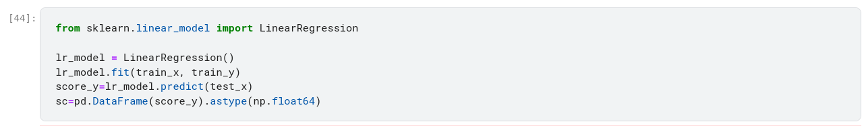
PREDICTION OF “alchemy_category_score”
The data corresponding to “?” is put into testing dataset.
Rest of the data is taken as training dataset.
“alchemy_category” score are numerical values
Predicting “alchemy_category_score” using Linear Regression.
LINEAR REGRESSION

Slide 6
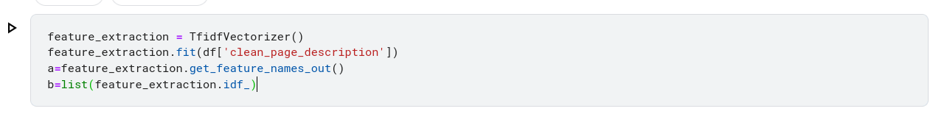
WORD2VEC
Word2vec represents each distinct word with a particular list of numbers called a vector. The vectors are chosen carefully such that they capture the semantic and syntactic qualities of words.
Word embeddings using shallow neural network

Slide 7
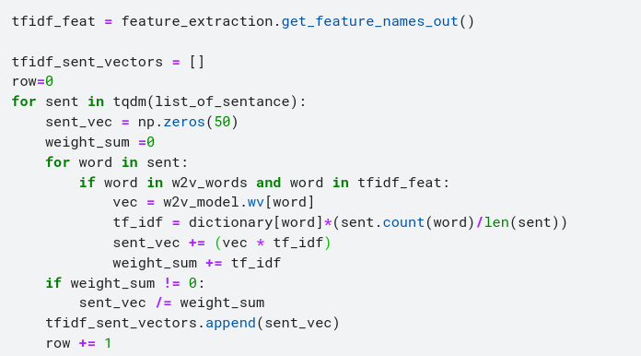
TFIDF weighted Word2Vec
Calculated tfidf value of each word and then by multiplying tfidf value with the corresponding word & then divided the sum by tfidf value’s sum.

Slide 8
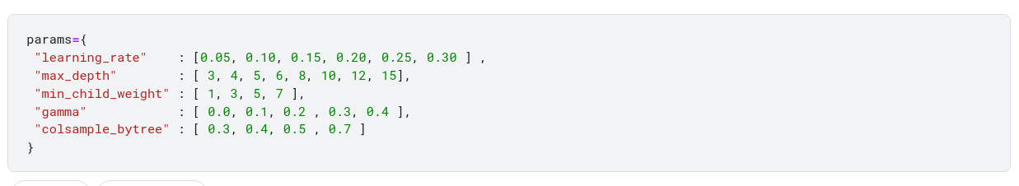
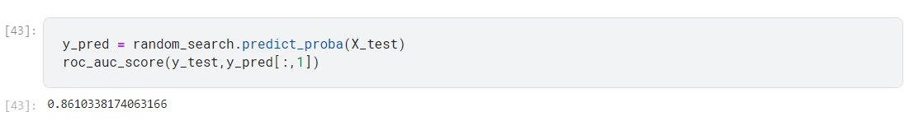
XG-Boost
XGBoost is an optimized distributed gradient boosting library designed to be highly efficient, flexible and portable.

